Slide 1


STUDYING THE MEOW MEOW OF MESOSCALE CATS
Master of Science in Environmental Meteorology
29° October 2024
Candidate: STORER Alessandro
Matriculation 240734
Supervisor: PASQUERO Claudia
Internal Supervisor: ZARDI Dino

Slide 2
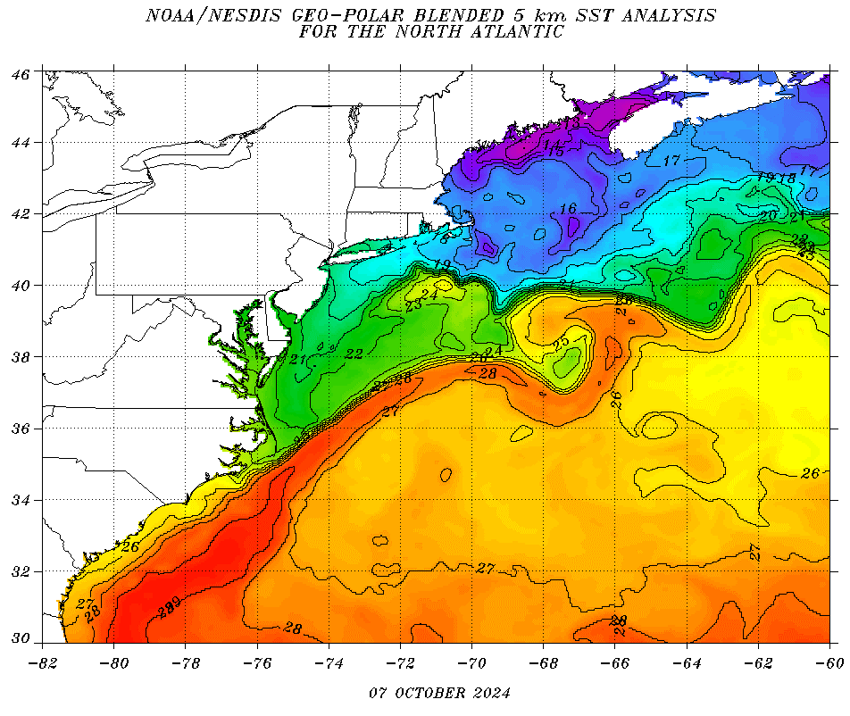
The Gulf Stream case
OPERATIONAL DEFINITION OF OCEANIC MESOSCALE
Notes:
The literature on GS is immense, I really cannot dedicate much time on it: just know that it is so energetic

Slide 3

Humidity
Radiative balance
Convective
organization
wind
SST
Turbulent fluxes
LHF, HFX
currents
Notes:
the coupling between marine shallow
trade-wind clouds and circulation is known to play a cen-
tral role in the uncertainty of the tropical cloud feedback and climate sensitivity estimated by models

Slide 4
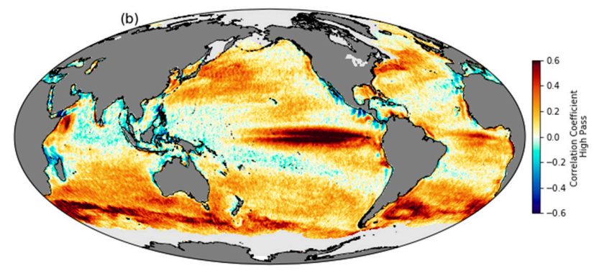
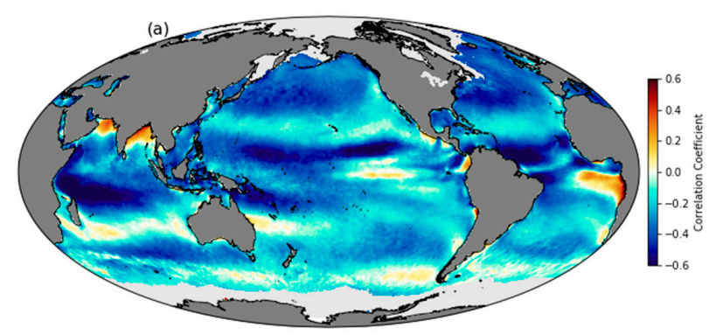
INTRODUCING THE LOCAL SCALE
Correlation between QuikScat wind speed and NOAA Optimum Interpolated SST using daily, 25-km-gridded data from 2000–2009.
Same, but for 1000km high-pass filtered data: notice the thorough change of correlation signs.
Gentemann et al. 2020

Slide 5
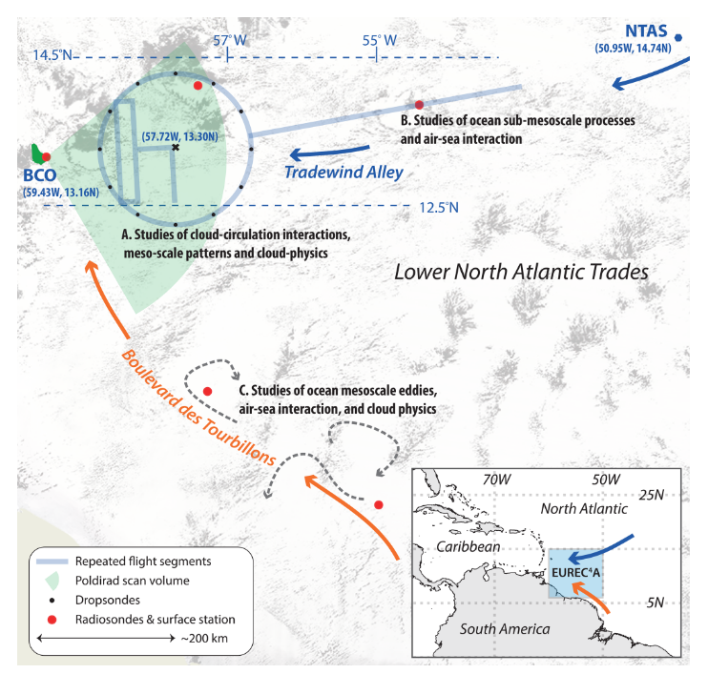
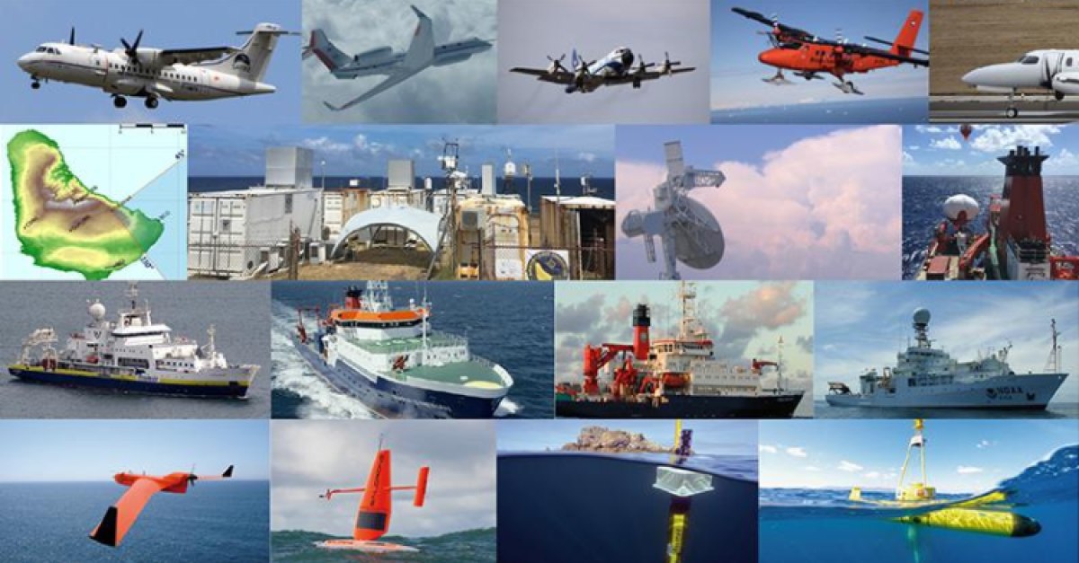
The EUREC4A campaign Stevens et al 2021
Investigate small scale air-sea coupling and cloud-convection feedbacks

Slide 6
CORE QUESTION
what is the impact of mesoscale SST variability
on the atmospheric fields and surface fluxes?
HOW? STATISTICAL ANALYSES
Response of air column
Sensitivity of HFs to SST
Analysis of LHF spatial variance
Simulation characteristics:
Ocean: CROCO, 1km, 4yr spin-up
Atmosphere: WRF v4.2 , 2km, 1-month spin up
COUPLING:
OASIS3-MCT coupler
WRF → CROCO: hourly means of momentum and heat fluxes
CROCO → WRF: SST-related heat fluxes and stress modifications by surface currents
Details in Conejero et al. 2024

Slide 7
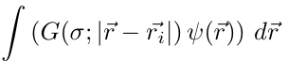
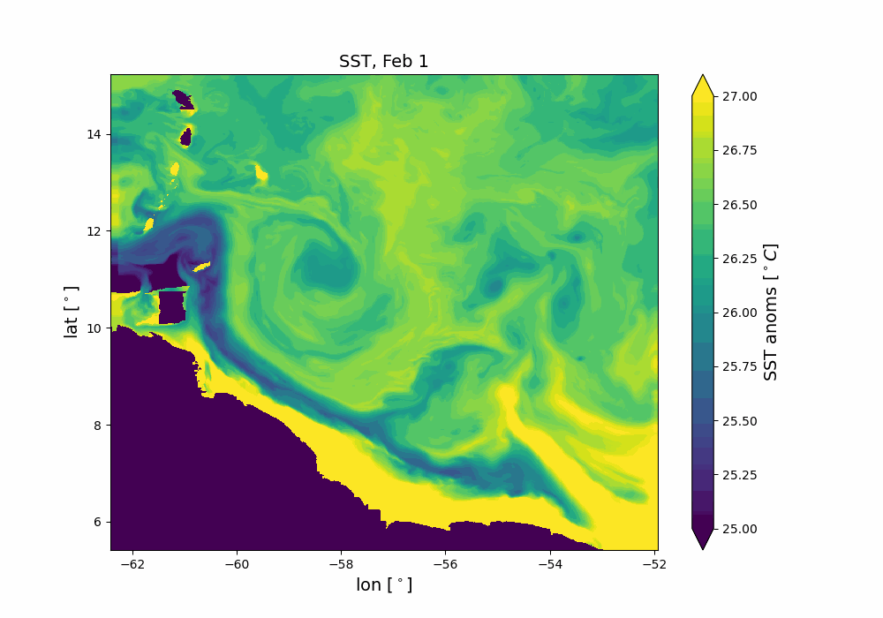
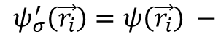
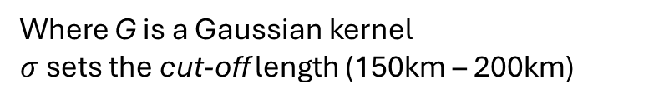
METHODS
1) Anomalies == high-pass filtered data
2) Percentile bins
$$ψ_{σ}^{′}\left(\vec{r_{i}}\right)=ψ\left(\vec{r_{i}}\right) −$$
Where G is a Gaussian kernel
$σ$ sets the cut-off length (150km – 200km)
3) Sensitivities or coupling coefficients

Slide 8
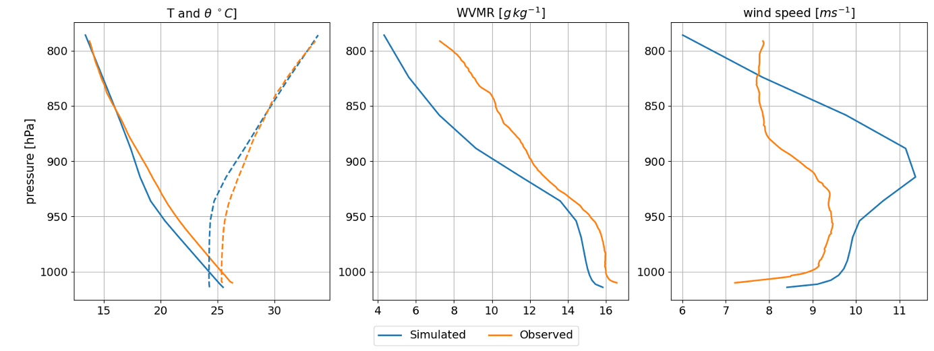

Slide 9
Chapter 1
Response of the air column following SST anomalies

Slide 10
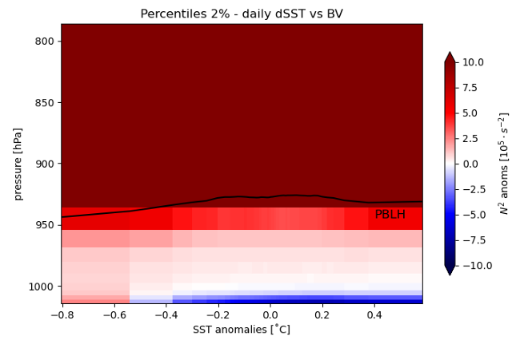
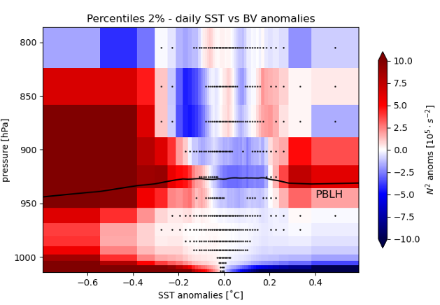
Notes:
Scale is common

Slide 14
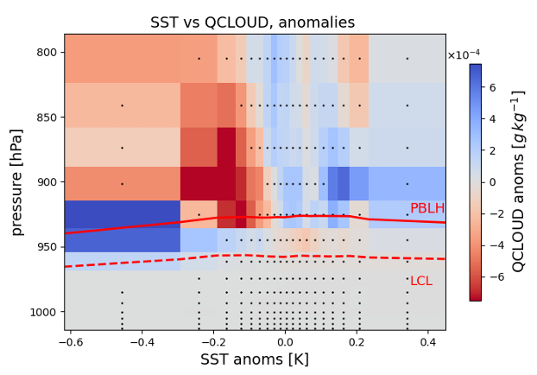

Slide 15
Chapter 2
Sensitivity of surface thermodynamic fluxes to SST

Slide 20
Chapter 3
How does SST contribute to shaping the spatial variability of LHF?

Slide 25
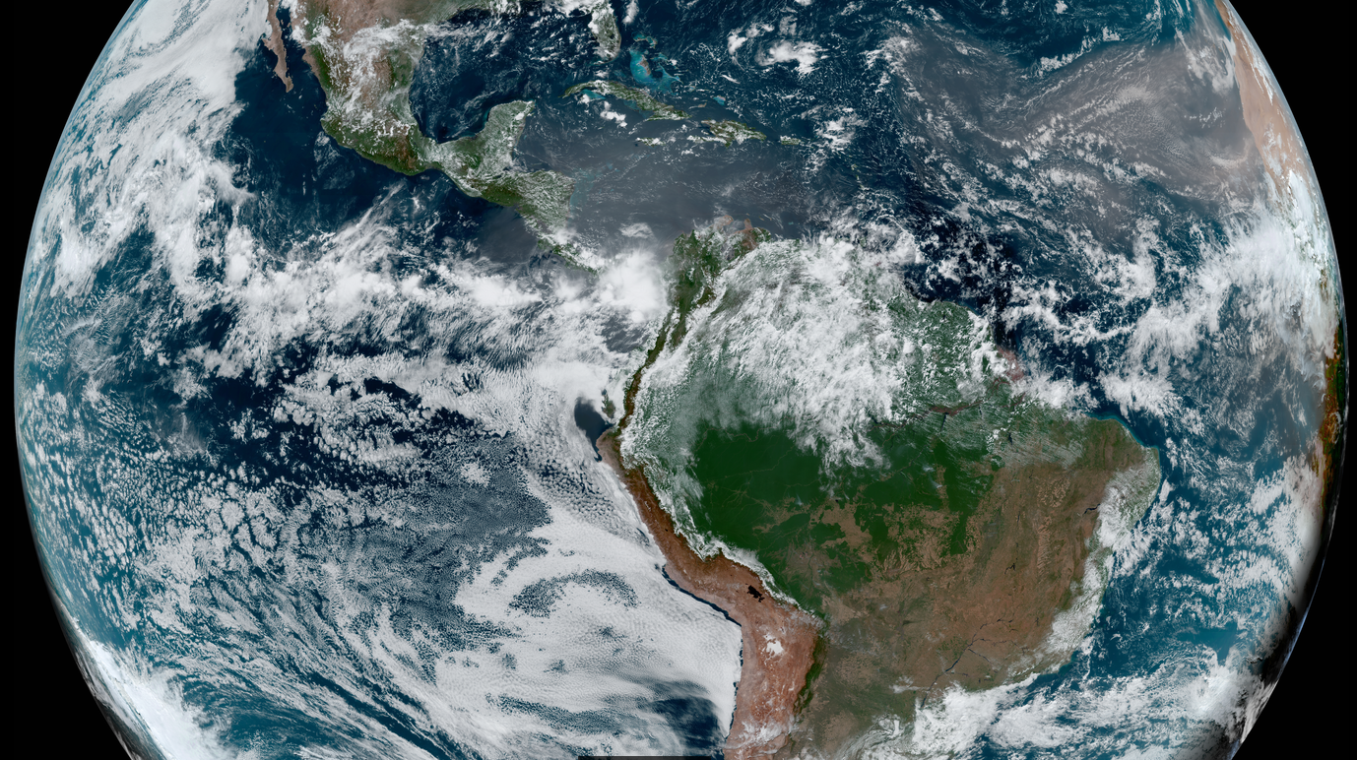

Slide 26
backups

Slide 27
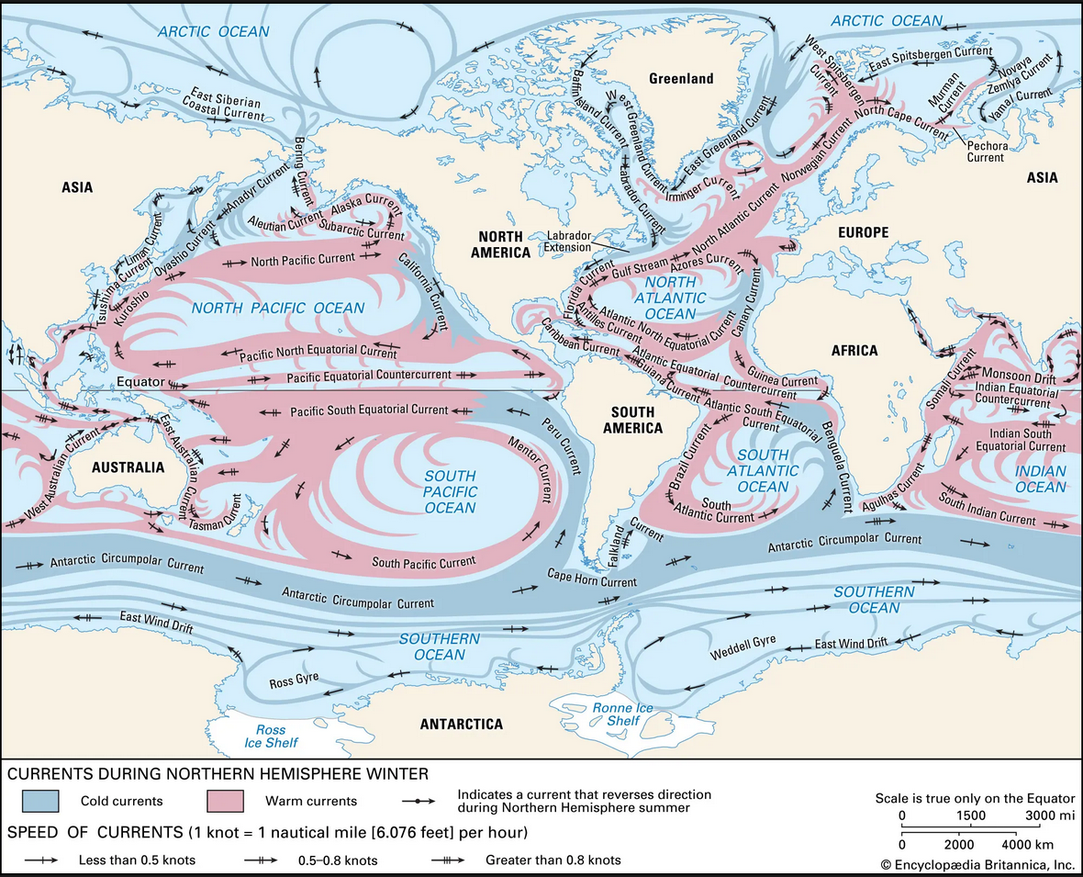
Be honest : How often do you think about oceans?

Slide 28
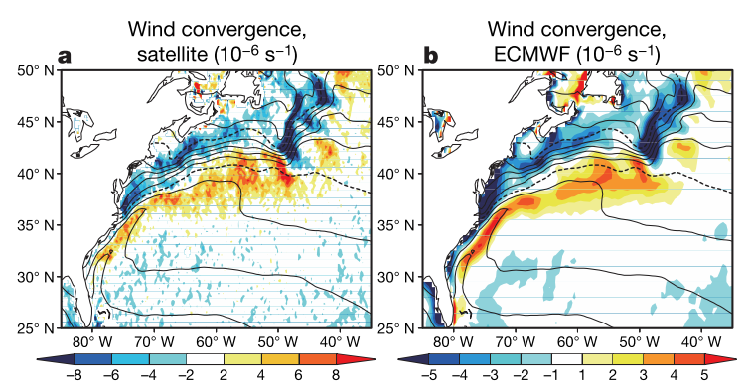
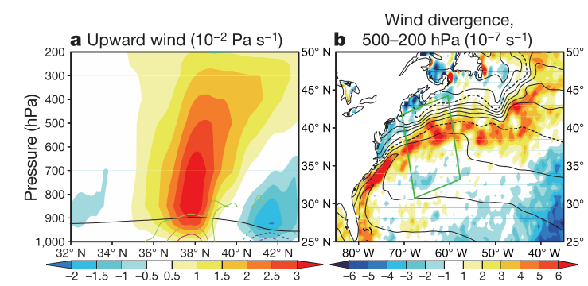
Not only MABL
GS is forcing the entire troposphere!
Minobe et al. 2010
Notes:
« to a surface convergence field, there corresponds a reaction by the whole troposphere

Slide 29
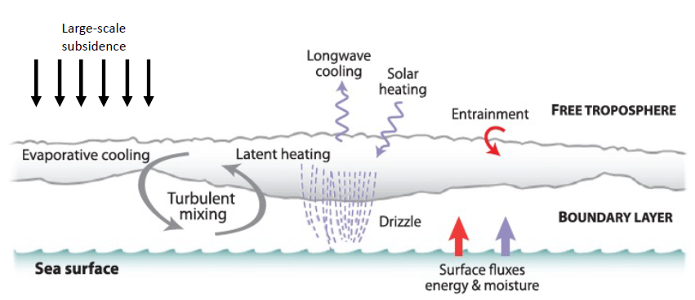
Credits: Allison Wing
WE CALL THIS
A COUPLED SYSTEM
Mettere magari un’immagine tratta da lavori su eurec4a

Slide 30
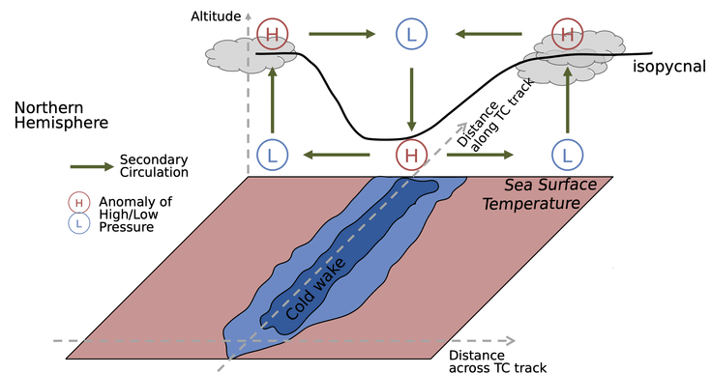
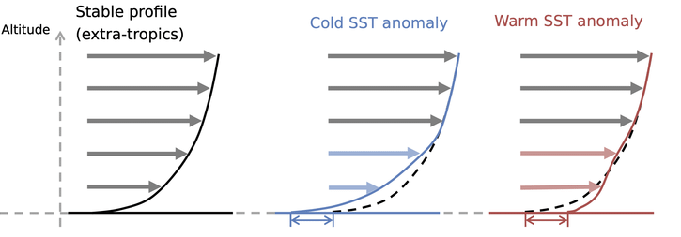
UNSURE ABOUT THIS SLIDE
TWO MAIN MABL RESPONSE MECHANISMS
Pressure Adjustment (PA)
THERMODYNAMIC FEEDBACK
Downward Momentum mixing (DMM)
$∇⋅\vec{u}=α_{PA}∇^{2}SST$
$∂_{r}u_{r}=α_{DM} ∂_{r}SST$
weak wind, neutral column
strong wind, unstable air
Secondary circulation
strong wind and
neutral stability conditions
Altitude
Mean profile
Wind speed
Pasquero et al. 2021, Desbiolles et al. 2023
Notes:
conditions relative to SST structure scale

Slide 31
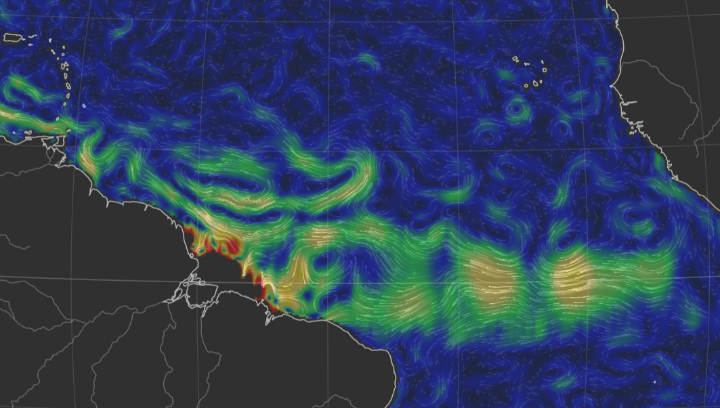
Reconstructed surface currents on 4th February 2020: peaks (yellow shadings) correspond to approx. 1m/s
Source: https://earth.nullschool.net/
Red box: the EUREC4A region
and computational domain

Slide 32
